Slide 1
PREPARAÇÃO TE
Todas as perguntas dos LE’s e mais
Soluções na zona dos comentários (em baixo)
Todas as perguntas estão misturados e não há nenhuma ordem
Algumas perguntas não são dos LE’s
Notes:
Soluções aqui!

Slide 2
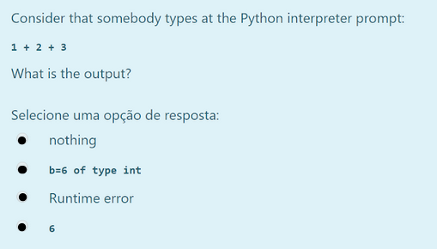
Notes:
Option 4

Slide 3
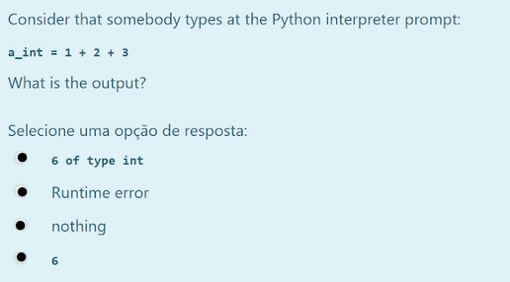
Notes:
Option 3

Slide 4
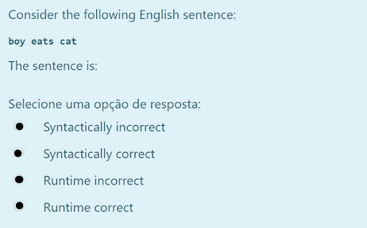
Notes:
Option 1

Slide 5
Given the following code fragment what is its Big-O running time?
cut = 0
for i in range(n):
for j in range(n):
cut += i * j
O(n)
O(n^2)
O(n log n)
O(n^3)
Notes:
Option 2

Slide 6
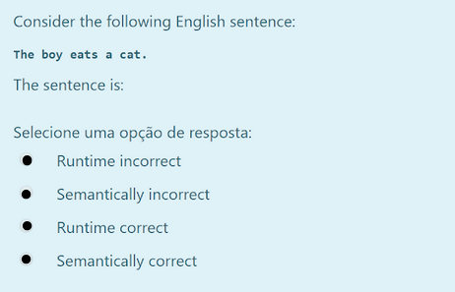
Notes:
Option 2

Slide 7
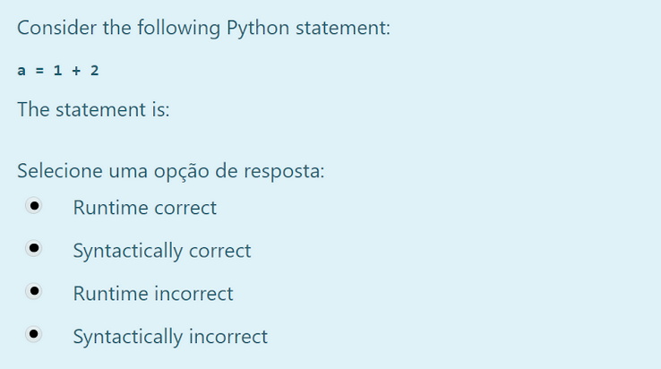
Notes:
Option 2

Slide 8
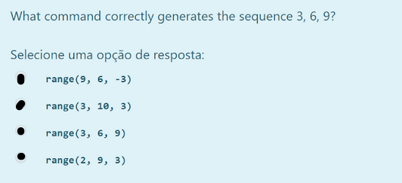
Notes:
Option 2

Slide 9
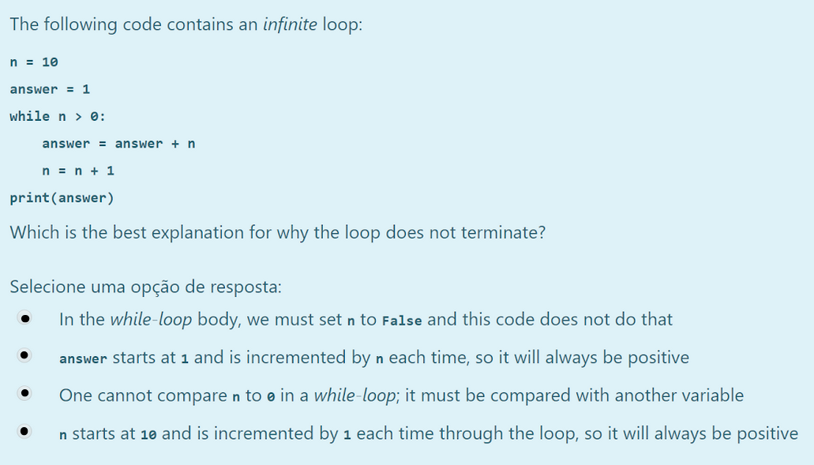
Notes:
Option 4

Slide 10
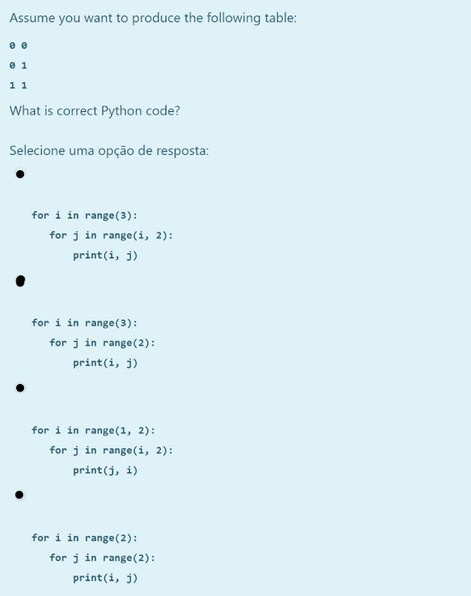
Notes:
Option 1

Slide 11
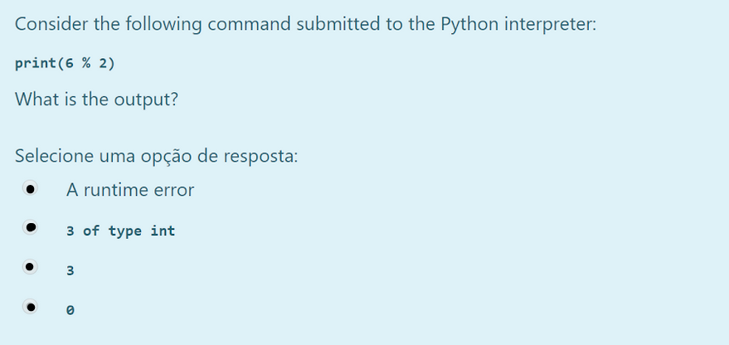
Notes:
Option 4

Slide 12
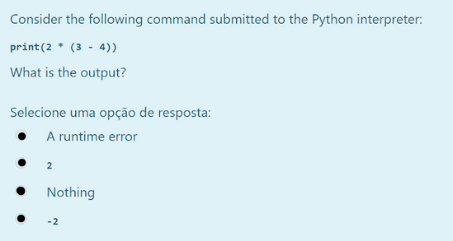
Notes:
Option 4

Slide 13
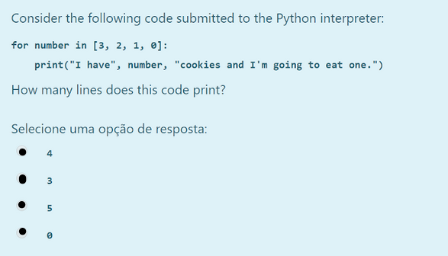
Notes:
Option 1

Slide 14
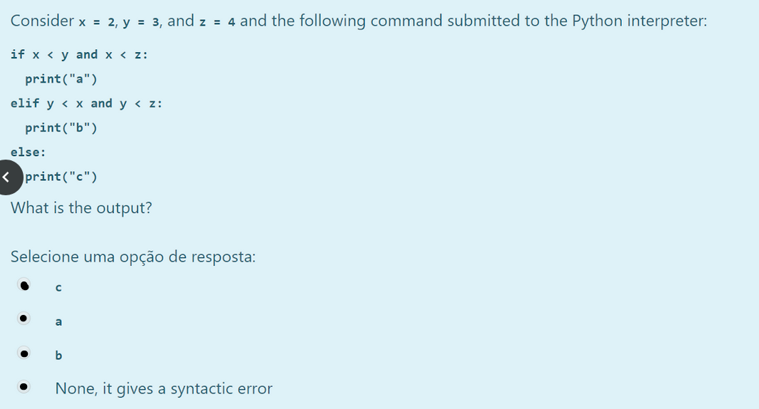
Notes:
Option 2

Slide 15
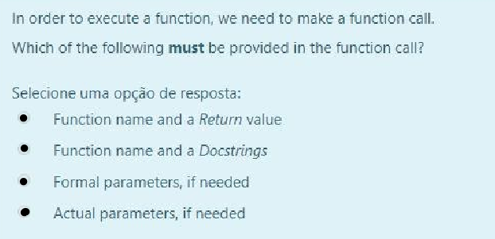
Notes:
Option 4

Slide 16
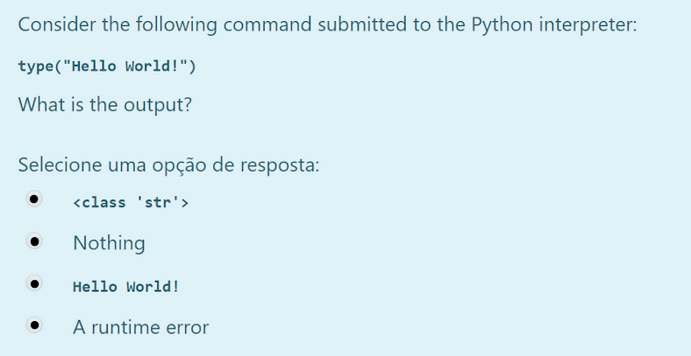
Notes:
Option 1

Slide 17
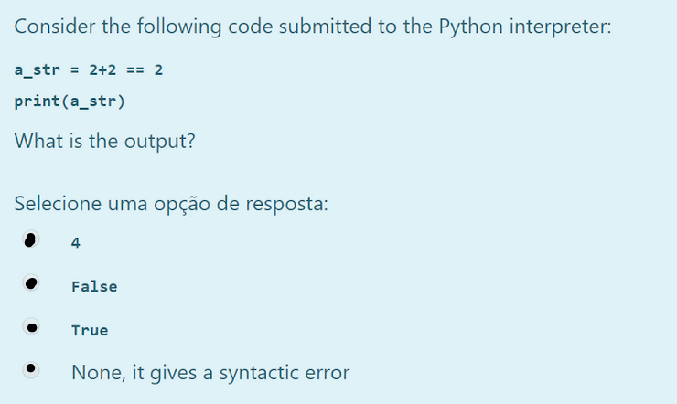
Notes:
Option 2

Slide 18
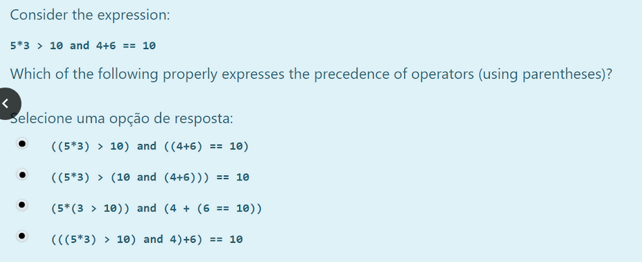
Notes:
Option 1

Slide 19
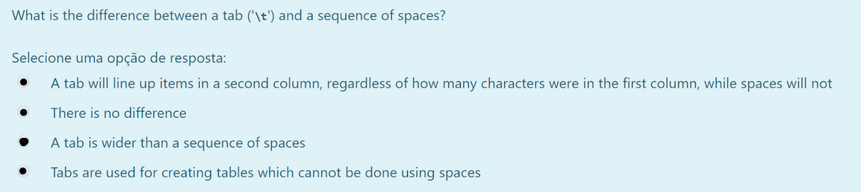
Notes:
Option 1

Slide 20
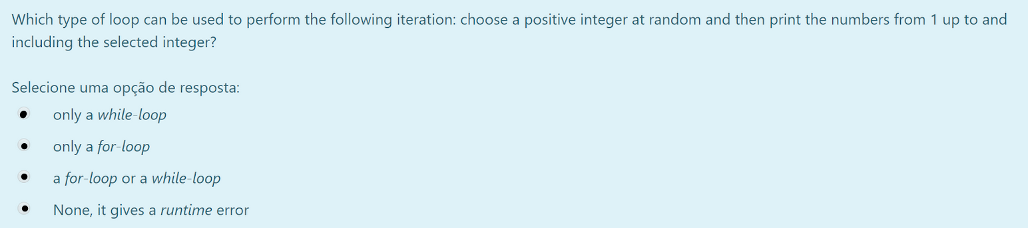
Notes:
Option 3

Slide 21
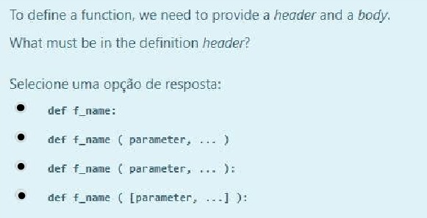
Notes:
Option 4

Slide 22
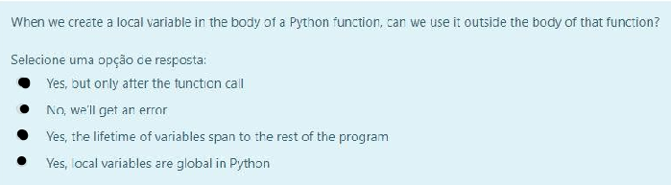
Notes:
Option 2

Slide 23
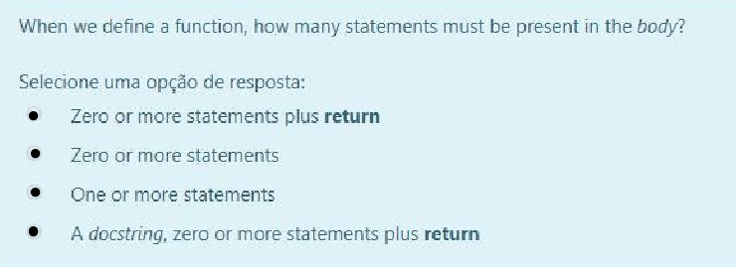
Notes:
Option 3

Slide 24
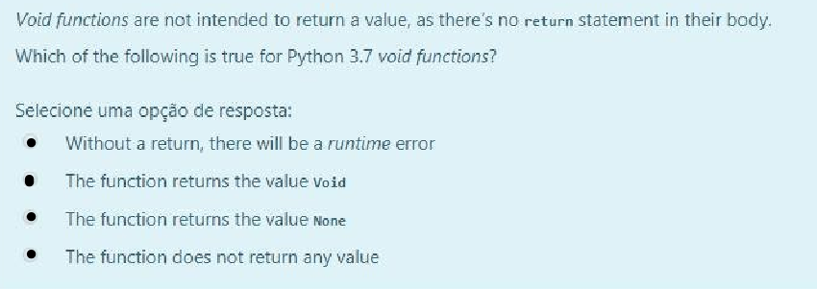
Notes:
Option 3

Slide 25
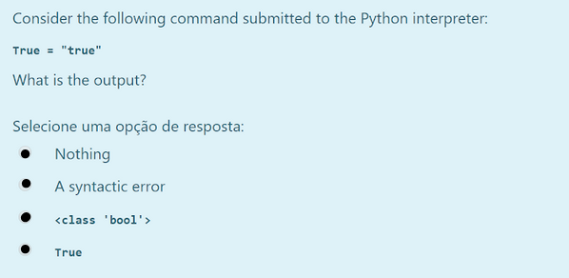
Notes:
Option 2

Slide 26
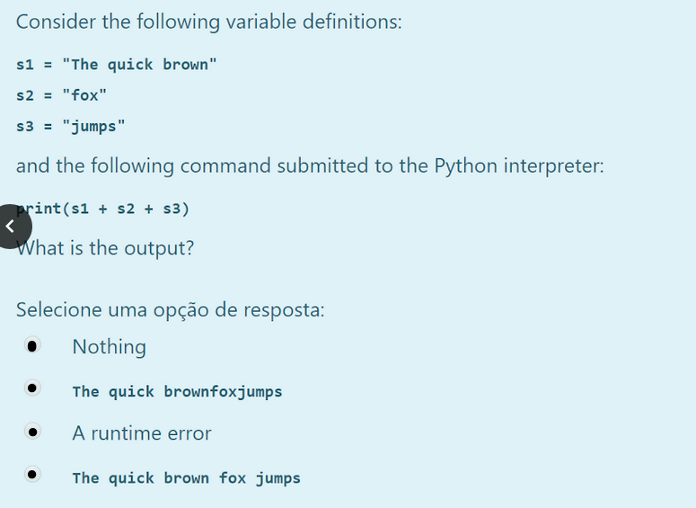
Notes:
Option 2

Slide 27
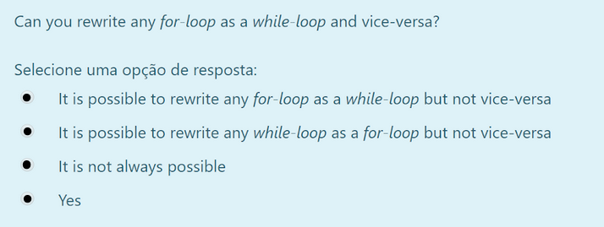
Notes:
Option 4

Slide 28
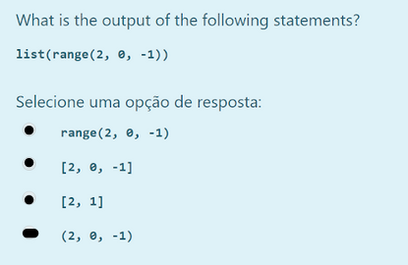
Notes:
Option 3

Slide 29
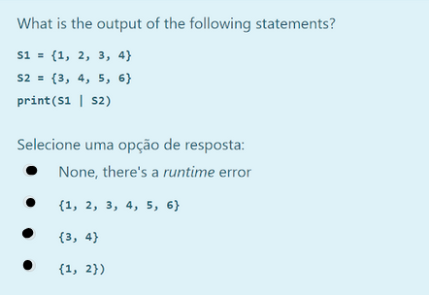
Notes:
Option 2

Slide 30
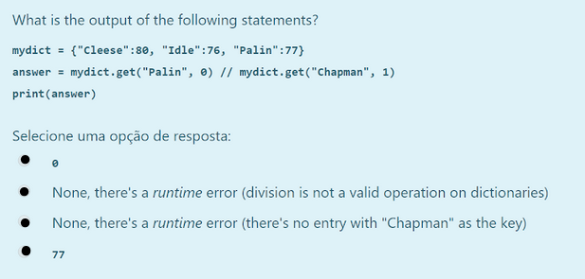
Notes:
Option 4

Slide 31
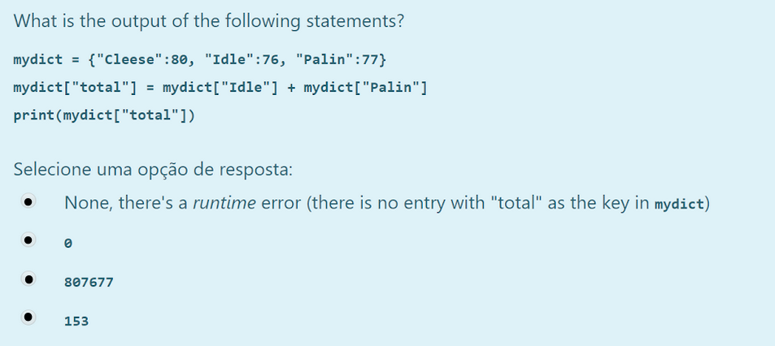
Notes:
Option 4

Slide 32
Which of the following is unit testing?
Test if a variable value is valid
Test PEP8 style
Test the code comments
Test the output of a function given a certain input
Notes:
Option 4

Slide 33
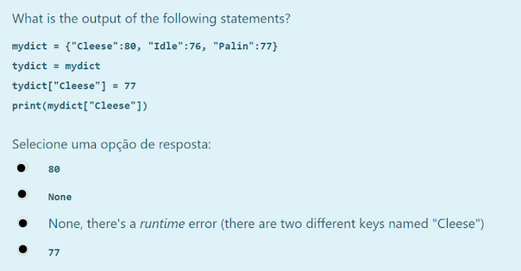
Notes:
Option 4

Slide 34
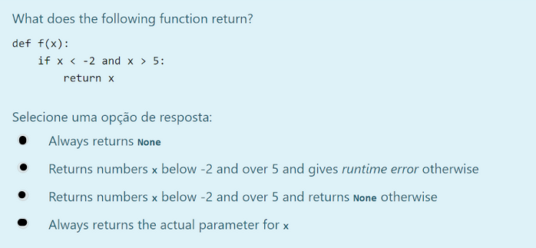
Notes:
Option 1

Slide 35
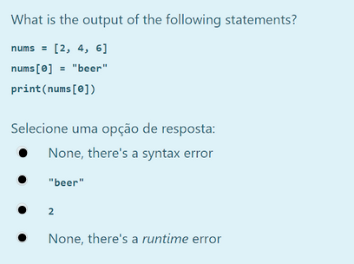
Notes:
Option 2

Slide 36
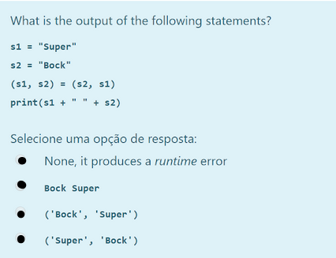
Notes:
Option 2

Slide 37
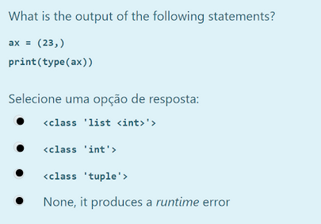
Notes:
Option 3

Slide 38
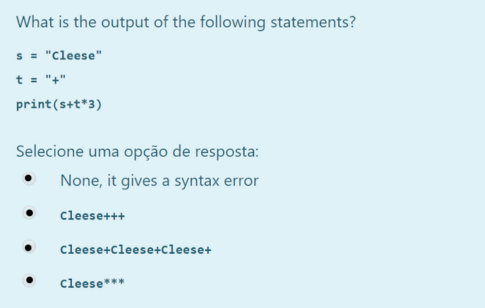
Notes:
Option 2

Slide 39
Which one is a suitable comment?
i += 1 #incrementing i
i += 1 #go to next element
i += 1 #this line is very important
i += 1 #adding 1 to i
Notes:
Option 2

Slide 40
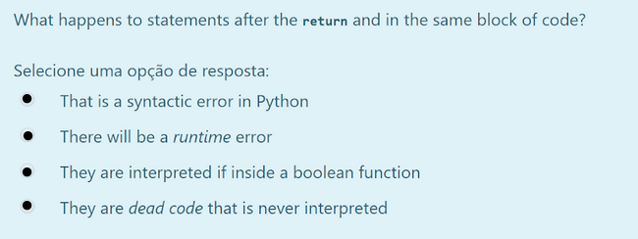
Notes:
Option 4

Slide 41
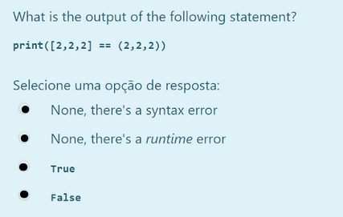
Notes:
Option 4

Slide 42
To what can assert can be used?
Ensure the program keeps running even if a variable value is invalid
To document the code
Crash the program as soon as a variable value is found to be invalid
It can be used only for variables
Notes:
Option 3

Slide 43
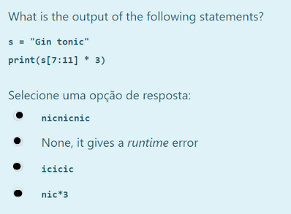
Notes:
Option 3

Slide 44
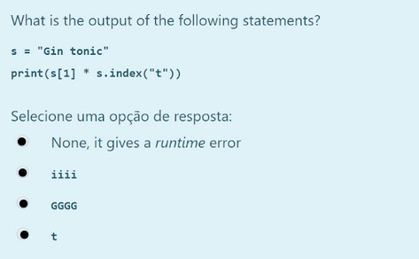
Notes:
Option 2

Slide 45
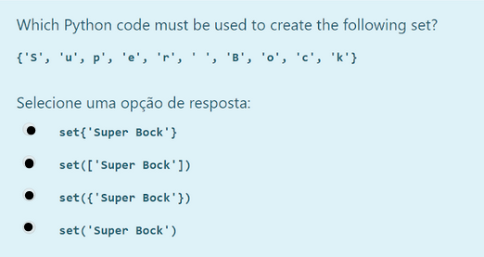
Notes:
Option 4

Slide 46
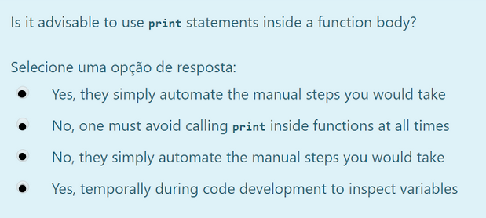
Notes:
Option 4

Slide 47
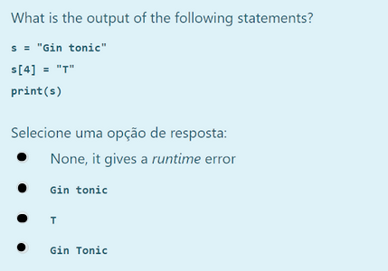
Notes:
Option 1

Slide 48
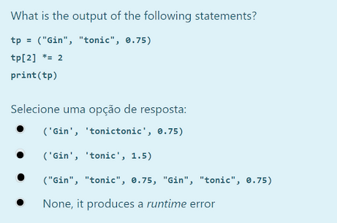
Notes:
Option 4

Slide 49
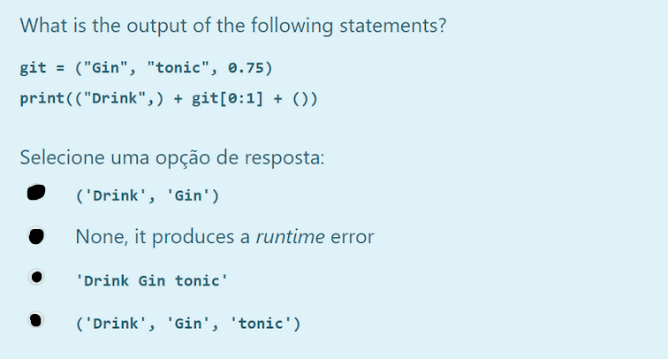
Notes:
Option 1

Slide 50
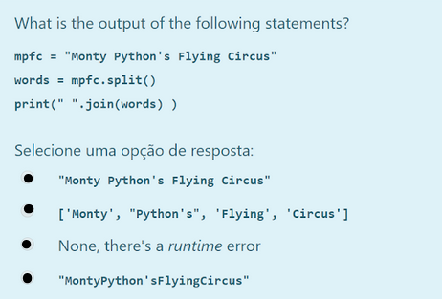
Notes:
Option 1

Slide 51
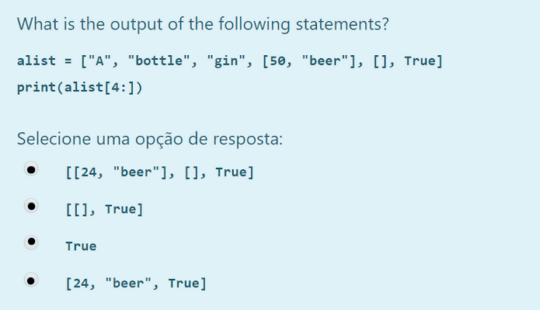
Notes:
Option 2

Slide 52
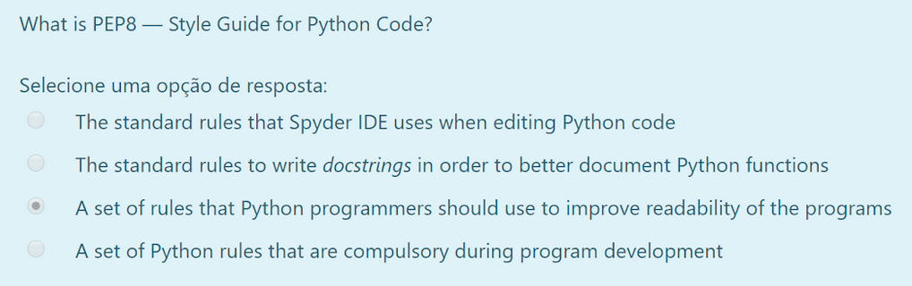
Notes:
Option 3

Slide 53
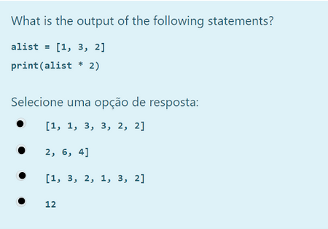
Notes:
Option 3

Slide 54
Which of the following is the output of the below Python code fragment?
x = True
y = False
z = False
if not x or y:
print(1)
elif not x or not y and z:
print(2)
elif not x or y or not y and x:
print(3)
else:
print(4)
2
1
3
4
None
Notes:
Option 3

Slide 55
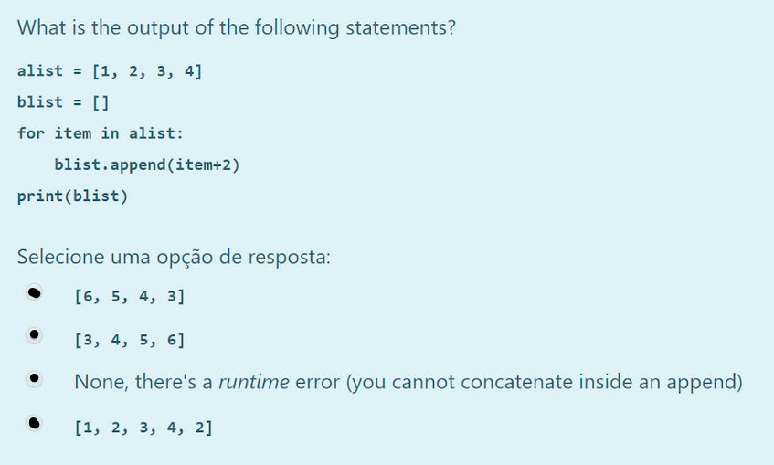
Notes:
Option 2

Slide 56
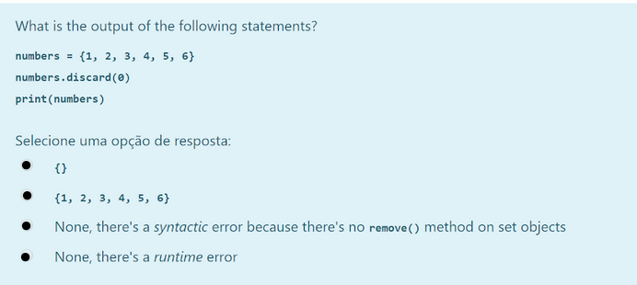
Notes:
Option 2

Slide 57

Notes:
Option 2

Slide 58

Notes:
Option 2

Slide 59

Notes:
Option 2

Slide 60

Notes:
Option 2

Slide 61

Notes:
Option 2

Slide 62

Notes:
Option 3

Slide 63

Notes:
Option 4

Slide 64

Notes:
Option 4 (with 3 instead of 4)

Slide 65
Which of the list operations shown below is not O(1)?
list[10]
list.pop()
list.append()
list.pop(0)
Notes:
Option 4. The address of the other elements has to be updated, when we remove the first element of the list.

Slide 66

Notes:
Option 3. It gives an UnboundLocalError: local variable 'itext' referenced before assignment. It’s not possible to modify variables, in inner_function, from outer_function (unless they’re global)

Slide 67
Which of the following is the output of the below Python code fragment?
def f1(x = 1, y = 2):
x = x + y
y += 1
print(x, y)
f1(y = 2, x = 1)
1 3
3 2
3 3
2 3
Notes:
Option 3

Slide 68

Notes:
Option 2

Slide 69
Given the following code fragment what is its Big-O running time?
k = n
while k > 0:
j += 2
k = k // 2
O(n^3)
O(n)
O(n^2)
O(log n)
Notes:
Option 4

Slide 70

Notes:
Option 2

Slide 71
Given the following code fragment what is its Big-O running time?
t = 0
for i in range(n):
t += 1
for j in range(n):
t -= 1
O(n^3)
O(n^2)
O(n log n)
O(n)
Notes:
Option 4

Slide 72

Notes:
Option 2

Slide 73

Notes:
Option 1

Slide 74

Notes:
Option 2

Slide 75
Which of the following is the output of the below Python code fragment?
counter = 1
def doLotsOfStuff():
global counter
for i in (1, 2, 3):
counter += 1
doLotsOfStuff()
print (counter)
3
7
1
4
None
Notes:
Option 4

Slide 76

Notes:
Option 3

Slide 77

Notes:
Option 4

Slide 78

Notes:
Option 4

Slide 79
Which of the following is the output of the below Python code fragment?
myList = [1, 5, 5, 5, 5, 1]
max = myList[0]
indexOfMax = 0
for i in range(1, len(myList)):
if myList[i] > max:
max = myList[i]
indexOfMax = i
print(indexOfMax)
1
0
3
2
4
Notes:
Option 1

Slide 80

Notes:
Option 3

Slide 81

Notes:
Option 3

Slide 82

Notes:
Option 4

Slide 83

Notes:
Option 4

Slide 84

Notes:
Option 1

Slide 85

Notes:
Option 2

Slide 86

Notes:
Option 4

Slide 87

Notes:
Option 4

Slide 88

Notes:
Option 2

Slide 89
Which of the following is the output of the following Python code?
d = {"python":40, "developer":45}
print(list(d.keys()))
["python":40, "developer":45]
["python", "developer"]
("python", "developer")
("python":40, "developer":45)
Notes:
Option 2

Slide 90

Notes:
Option 2

Slide 91

Notes:
Option 3

Slide 92

Notes:
Option 1

Slide 93

Notes:
Option 4

Slide 94

Notes:
Option 2

Slide 95

Notes:
Option 3

Slide 96

Notes:
Option 4

Slide 97

Notes:
Option 2

Slide 98
Which of the following is the output of the below Python code fragment?
x = 2
y = 1
x *= y + 1
print(x)
x is 2
x is 3
x is 1
None
x is 4
Notes:
Option 5

Slide 99

Notes:
Option 4

Slide 100

Notes:
Option 1

Slide 101

Notes:
Option 1

Slide 102

Notes:
Option 3

Slide 103

Notes:
Option 3

Slide 104

Notes:
Option 3

Slide 105

Notes:
Option 1

Slide 106
Which of the following is the output of the following Python code?
Nums = set ([1,1,2,3,3,3,4])
print (len(Nums))
4
5
1
7
2
Notes:
Option 1

Slide 107

Notes:
Option 1

Slide 108

Notes:
Option 3

Slide 109

Notes:
Option 4

Slide 110

Notes:
Option 3

Slide 111
Which of the following is the output of the below Python code fragment?
list1 = [1, 3]
list2 = list1
list1[0] = 4
print(list2)
[1, 3]
[1, 3, 4]
[4, 3]
[1, 4]
Notes:
Option 3

Slide 112

Notes:
Option 3

Slide 113

Notes:
Option 4

Slide 114

Notes:
Option 3

Slide 115

Notes:
Option 2. ‘r’ opens for reading and ‘+’ opens a disk file for updating (reading and writing)

Slide 116

Notes:
Option 2

Slide 117

Notes:
Option 1

Slide 118

Notes:
Option 4

Slide 119

Notes:
Option 4

Slide 120

Notes:
Option 2

Slide 121

Notes:
Option 2

Slide 122

Notes:
Option 1

Slide 123
Which of the following is the output of the following Python code?
def factorial(n):
return n * factorial(n - 1)
Invoking factorial(1) returns 1.
Invoking factorial(2) returns 2.
Invoking factorial(0) returns 0.
The function runs infinitely.
Notes:
Option 4

Slide 124
What is output for
a = ['he', 'she', 'we']
' '.join(a)
[‘heshewe’]
‘heshewe’
[‘he she we’]
‘he she we´
Notes:
Option 2

Slide 125
What is output for
b = [11,13,15,17,19,21]
print(b[::2])
[19, 21]
[11, 15]
[11, 15, 19]
[13, 17, 21]
Notes:
Option 3. Prints all the elements in the list two by two

Slide 126
Select the option for following code
s = 0
for d in range(0, 5, 0.1):
s += d
print(s)
Syntax Error
Type Error
Runtime Error
Both option 1 and 2
Notes:
Option 2

Slide 127
What is output of following
print(''abbzxyzxzxabb''.count(‘abb’,-10,-1))
2
0
1
Error
Notes:
Option 2

Slide 128
Select the option for following code
try:
list = 5*[0]+5*[10]
x = list[9]
print(''Done!'')
except IndexError:
print(''Index out of Bond! '')
else:
print(''Nothing is wrong!'')
finally:
print(''Finally block!'')
‘Finally Block!’
‘Done! follow by ‘Nothing is wrong!’
‘Nothing is wrong!’ followed by ‘Finally block’.
‘Done!’ follow by ‘Nothing is wrong!’ followed by ‘Finally block’.
Notes:
Option 4

Slide 129
Which among them is correct(s) about Recursive Function?
They are much faster than the normal functions
They take more space then the non-recursive functions
They can always be replaced by non-recursive functions
Using recursive functions however also gives a natural and straight forward simple solution for the program.
Notes:
Option 2,3,4

Slide 130
Which module is used in python to create Graphics?
Turtle
Canvas
Tkinter
Graphics
Notes:
Option 1

Slide 131
What will be the output of the following code :
print type(type(int))
type ‘int’
type ‘type’
Error
0
Notes:
Option 2. The type() function returns the class of the argument the object belongs to. Thus, type(int) returns which is of the type ‘type’ object.

Slide 132
What is the output of the following code :
L = ['a','b','c','d']
print "".join(L)
Error
None
abcd
[‘a’, ‘b’, ‘c’, ‘d’]
Notes:
Option 3. “” depicts a null string and the join function combines the elements of the list into a string.

Slide 133
What is the output of the following segment :
chr(ord('A'))
A
B
a
Error
Notes:
Option 1. ord() function converts a character into its ASCII notation and chr() converts the ASCII to character.

Slide 134
What is the output of the following program :
y = 8
z = lambda x : x * y
print z(6)
48
14
64
None of the above
Notes:
Option 1. lambdas are concise functions and thus, result = 6 * 8

Slide 135
Suppose list1 is [3, 4, 5, 20, 5, 25, 1, 3], what is list1 after list1.pop(1)?
[3, 4, 5, 20, 5, 25, 1, 3]
[1, 3, 3, 4, 5, 5, 20, 25]
[3, 5, 20, 5, 25, 1, 3]
[1, 3, 4, 5, 20, 5, 25]
Notes:
Option 3. pop(i) removes the i^{th} index element from the list

Slide 136
What is the output of the following program :
i = 0
while i < 3:
print i
i++
print i+1
0 2 1 3 2 4
0 1 2 3 4 5
Error
1 0 2 4 3 5
Notes:
Option 3. There is no operator ++ in Python

Slide 137
What is the output of the expression : 3*1**3
27
9
3
1
Notes:
Option 3. Precedence of ** is higher than that of 3, thus first 1**3 will be executed and the result will be multiplied by 3.

Slide 138
What is the output of the following program :
print '{0:.2}'.format(1.0 / 3)
0.3333333
0.33
0.3333333:-2
Error
Notes:
Option 2. .2 defines the precision of the floating point number.

Slide 139
What is the output of the following program :
i = 0
while i < 3:
print i
i += 1
else:
print 0
0 1 2 3 0
0 1 2 0
Error
Runs infinitely
Notes:
Option 2. The else part is executed when the condition in the while statement is false.

Slide 140
What is the output of the following program :
i = 0
while i < 5:
print(i)
i += 1
if i == 3:
break
else:
print(0)
0 1 2 0
0 1 2
Error
None of the above
Notes:
Option 2. The else part is not executed if control breaks out of the loop.

Slide 141
What is the output of the following program :
print 'abcefd'.replace('cd', '12')
ab1ef2
abcefd
ab1efd
ab12ed2
Notes:
Option 2. The first substring is not present in the given string and hence nothing is replaced.

Slide 142
What will be displayed by the following code?
def f(value, values):
v = 1
values[0] = 44
t = 3
v = [1, 2, 3]
f(t, v)
print(t, v[0])
1 1
1 44
3 1
3 44
Notes:
Option 4. The value of t=3 is passed in funcion f(value,values) , v [list] is passed as values in the same function. The v is stored in values and values[0]=44 , changes the value at index[‘0’] in the list hence v=[44,2,3].

Slide 143
Which of the following statements is true?
Python is a high level programming language.
Python is an interpreted language.
Python is an object-oriented language.
All of the above.
Notes:
Option 4

Slide 144
Which of the following is correct?
Variable name can start with an underscore.
Variable name can start with a digit.
Keywords cannot be used as a variable name.
Variable name can have symbols like: @, #, $ etc.
Notes:
Option 1

Slide 145
What is the output of the following code?
print(1, 2, 3, 4, sep='*')
1 2 3 4
1234
1*2*3*4
24
Notes:
Option 3

Slide 146
Suppose a list with name test, contains 10 elements. You can get the 5th element from the test list using:
test[5]
test[4]
test['5']
test['4']
Notes:
Option 2

Slide 147
What is the output of the following program?
language = ['P', 'y', 't', 'h', 'o', 'n']
print(language[:-4])
'Py'
['P', 'y']
['P', 'y', 't', 'h', 'o']
[-4]
Notes:
Option 2

Slide 148
Suppose a tuple test contains 5 elements. How can you set the 3rd element of the tuple to ‘Python’?
test[2] = 'Python'
test(2) = 'Python'
test[3] = 'Python'
Elements of tuple cannot be changed
Notes:
Option 4

Slide 149
What is the output of the following program?
print((1, 2) + (3, 4))
(4, 6)
(1, 2, 3, 4)
((1, 2), (3, 4))
Error!
Notes:
Option 2

Slide 150
What is the output of the following program?
names = "{1}, {2} and {0}".format('John', 'Bill', 'Sean')
print(names)
John, Bill and Sean
Bill, Sean and John
John, Bill
Bill, Sean
Notes:
Option 2

Slide 151
Which of the following statement is true?
A set is an unordered collection of items.
Elements of set are unique.
You can change elements of set unlike tuple.
All of the above.
Notes:
Option 4

Slide 152
What is the output of the following program?
n = [x*x for x in range(4)]
print(n)
[0, 1, 2, 3]
[0, 1, 4, 9]
[1, 4, 9, 16]
[1, 2, 3, 4]
Notes:
Option 2

Slide 153
How can you change
num = {‘one’: 1, ‘two’: 3} to
num = {‘one’: 1, ‘two’: 2}
num[2] = 'two'
num[1] = 'two'
num['two'] = 2
num['two'] = '2'
Notes:
Option 3

Slide 154
What is the output of the following program?
squares = {1:1, 2:4, 3:9, 4:16, 5:25}
print(squares.pop(4))
print(squares)
16 {1: 1, 2: 4, 3: 9, 5: 25}
16 {1: 1, 2: 4, 3: 9, 4:16, 5: 25}
4 {1: 1, 2: 4, 3: 9, 5: 25}
4 {1: 1, 2: 4, 3: 9, 4:16, 5: 25}
Notes:
Option 1

Slide 155
What is the output of the following code?
if None:
print(“Hello”)
False
Hello
Nothing will be printed
Syntax error
Notes:
Option 3

Slide 156
The if...elif...else executes only one block of code among several blocks.
True
False
It depends on expression used.
There is no elif statement in Python.
Notes:
Option 1

Slide 157
What is the output of the following code?
for i in [1, 0]:
print(i+1)
2 1
[2, 1]
2 0
[2, 0]
Notes:
Option 1

Slide 158
In Python, for and while loop can have optional else statement?
Only for loop can have optional else statement
Only while loop can have optional else statement
Both loops can have optional else statement
Loops cannot have else statement in Python
Notes:
Option 3

Slide 159
What is the output of the following code?
i = sum = 0
while i <= 4:
sum += i
i = i+1
print(sum)
0
10
4
None of the above
Notes:
Option 2

Slide 160
What is the output of the following code?
while 4 == 4:
print('4')
4 is printed once
4 is printed four times
4 is printed infinitely until program closes
Syntax error
Notes:
Option 3

Slide 161
Is it better to use for loop instead of while if you are iterating through a sequence (like: list)?
No, it’s better to use while loop.
Yes, for loop is more pythonic choice.
No, you cannot iterate through a sequence using while loop.
No, you cannot iterate through a sequence using loops.
Notes:
Option 2

Slide 162
Which of the following statement is true?
The break statement terminates the loop containing it.
The continue statement is used to skip the rest of the code inside the loop.
The break and continue statements are almost always used with if, if...else and if...elif...else statements.
All of the above.
Notes:
Option 4

Slide 163
What is the output of the following code?
for char in 'PYTHON STRING':
if char == ' ':
break
print(char, end='')
if char == 'O':
continue
PYTHON
PYTHONSTRING
PYTHN
STRING
Notes:
Option 1

Slide 164
Which of the following statement is true about the pass statement?
The Python interpreter ignores the pass statement like comments.
The pass statement terminates the loop containing it.
It is used as a placeholder for future implementation of functions, loops etc
All of the above.
Notes:
Option 3

Slide 165

Notes:
Option 5

Slide 166

Notes:
Option 4

Slide 167

Notes:
Option 2

Slide 168

Notes:
Option 4

Slide 169

Notes:
Option 2

Slide 170
Opening a file in ‘a’ mode
opens a file for reading
opens a file for writing
opens a file for appending at the end of the file
opens a file for exclusive creation
Notes:
Option 3

Slide 171
What does the following code do?
f = open("test.txt")
Opens test.txt file for both reading and writing
Opens test.txt file for reading only
Opens test.txt file for writing only
Opens test.txt file in god mode
Notes:
Option 2

Slide 172
Which of the following codes closes file automatically if exception occurs?
with open("test.txt", encoding = 'utf-8') as f:
# perform file operation
try:
f = open("test.txt",encoding = 'utf-8')
# perform file operations
finally:
f.close()
None of the above
Both of the above
Notes:
Option 4

Slide 173
For the following code,
f = open('test.txt', 'r', encoding = 'utf-8')
f.read()
Which of the following statement is true?
This program reads the content of test.txt file.
If test.txt contains newline, read() will return newline as ‘\n’.
You can pass an integer to the read() method.
All of the above.
Notes:
Option 4

Slide 174
What does the following code do?
os.listdir()
Prints the current working directory.
Prints all directories (not files) inside the given directory.
Prints all directories and files inside the given directory.
Makes a new directory.
Notes:
Option 3

Slide 175
Which of the following is correct?
An exception is an error that occurs at the runtime.
A syntax error is also an exception.
An exception is used to exclude a block of code in Python.
All of the above.
Notes:
Option 1

Slide 176
What will happen if you try to open a file that doesn’t exist, without mode specified?
A new file is created.
Nothing will happen.
An exception is raised.
None of the above.
Notes:
Option 3

Slide 177
What is the output of the following code?
number = 5.0
try:
r = 10/number
print(r)
except:
print("Oops! Error occurred.")
Oops! Error occurred.
2.0
2.0 Oops! Error occurred.
None object
Notes:
Option 2

Slide 178
What does the following code do?
try:
# code that can raise error
pass
except (TypeError, ZeroDivisionError):
print("Two")
Prints Two if exception occurs (doesn’t matter which exception).
Prints Two if exception doesn’t occur.
Prints Two if TypeError or ZeroDivisionError exception occurs.
Prints Two only if both TypeError and ZeroDivisionError exception occurs.
Notes:
Option 3

